Slide 1
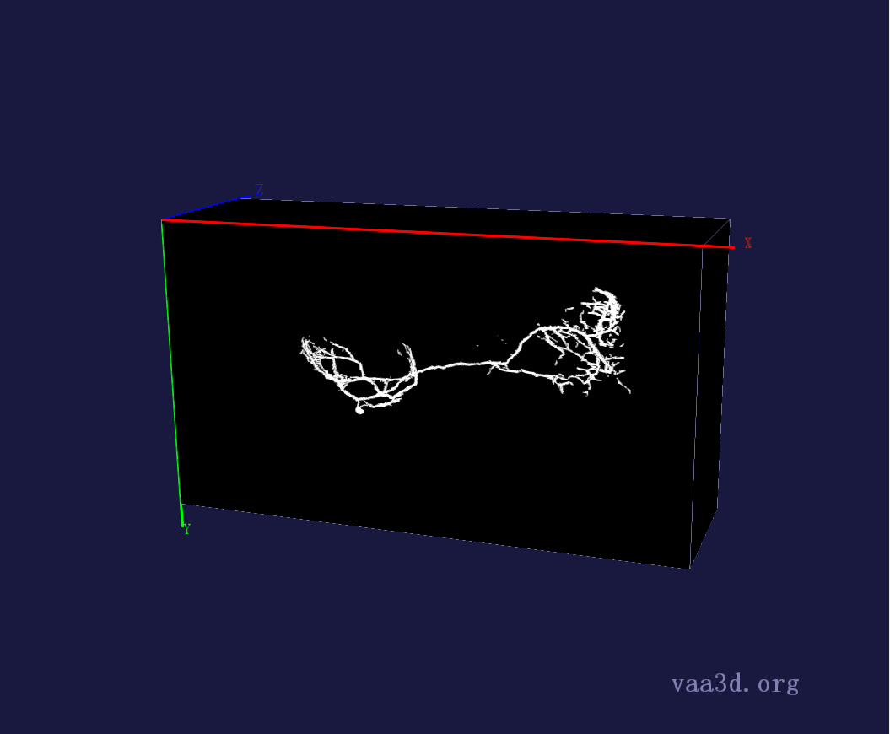
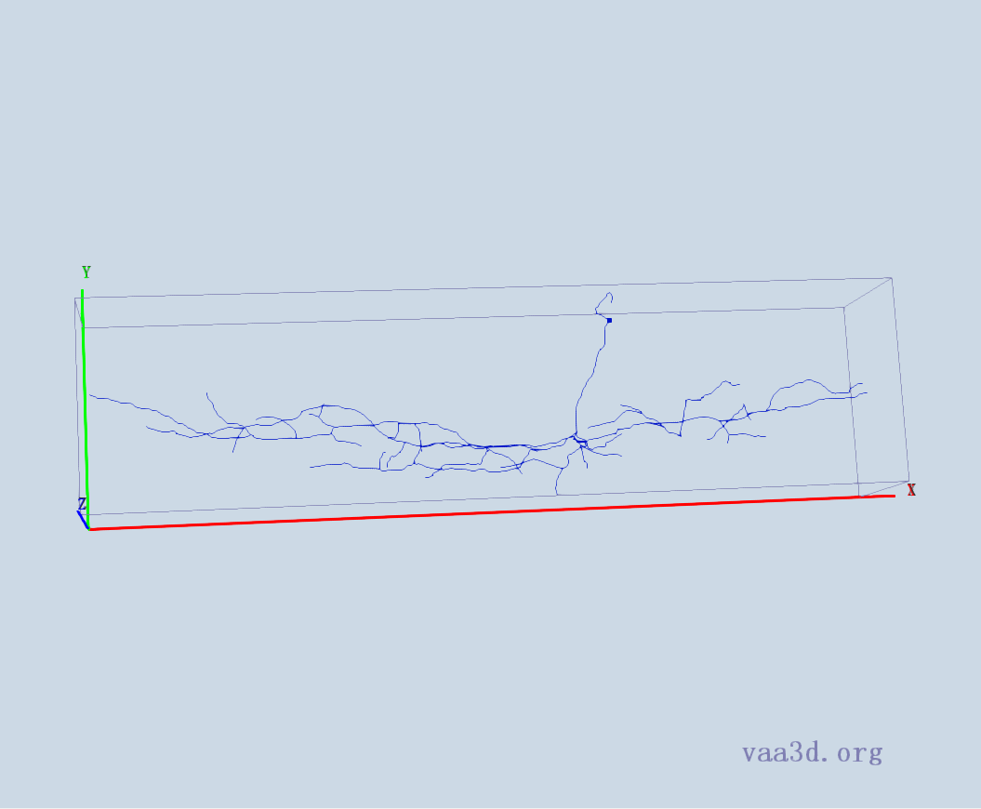
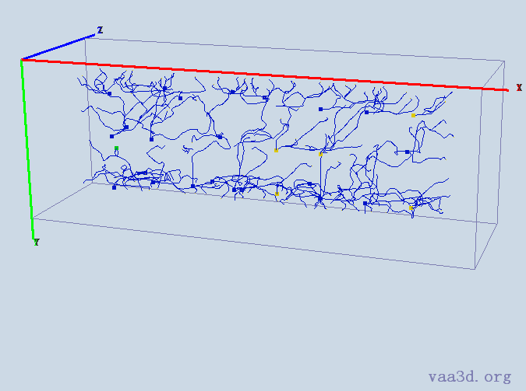
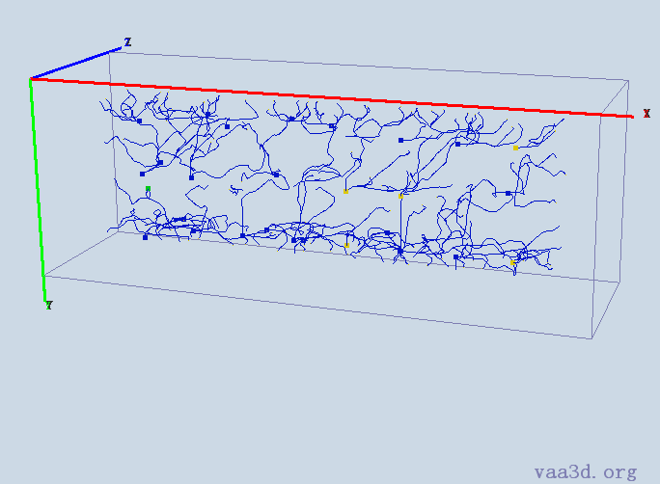
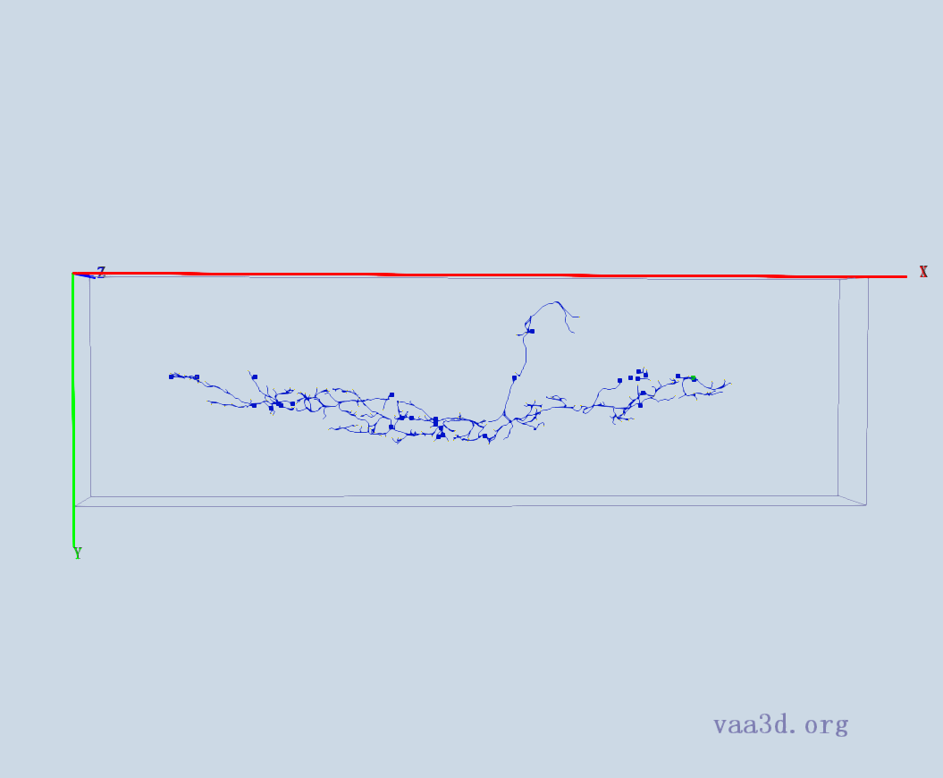
1_5dpf_Live_1-30-2010_12-39-26_PM_med_Red
GT
Thre=10
Thre=15
Thre=30
Thre=40
Thre=50
Thre=75

Slide 2
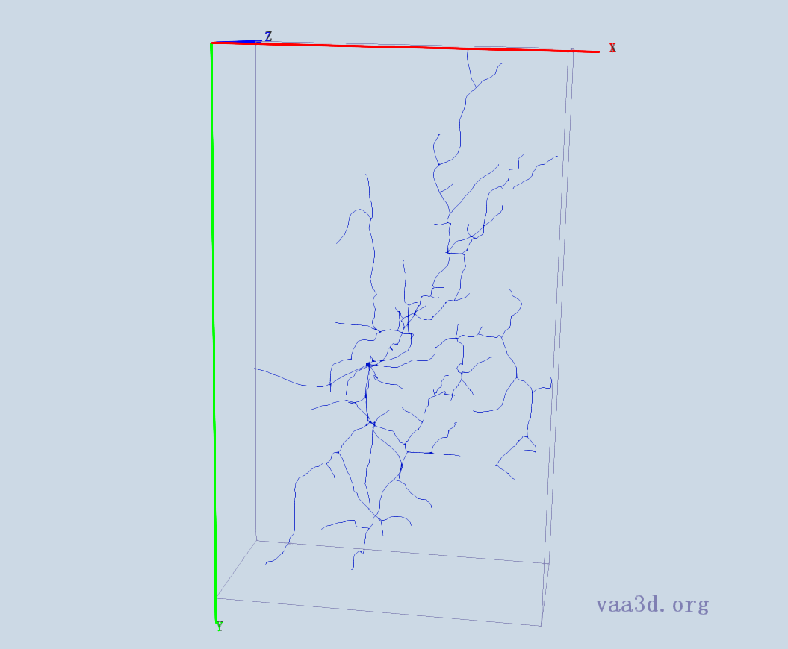
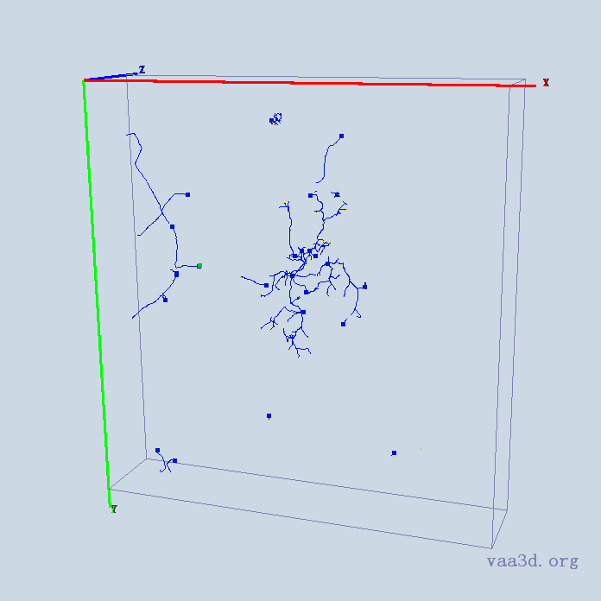
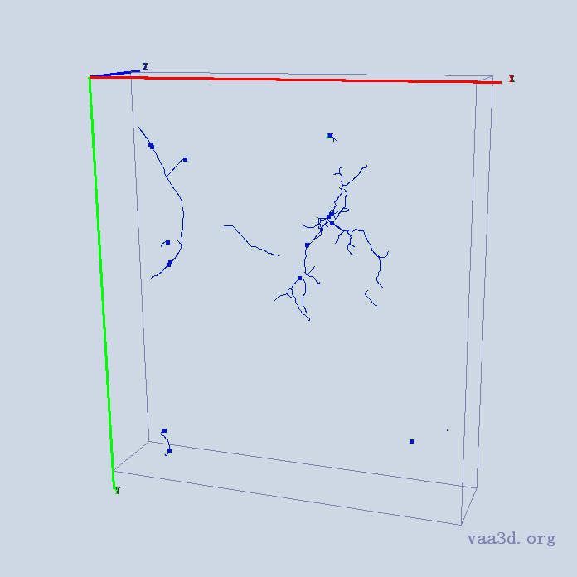
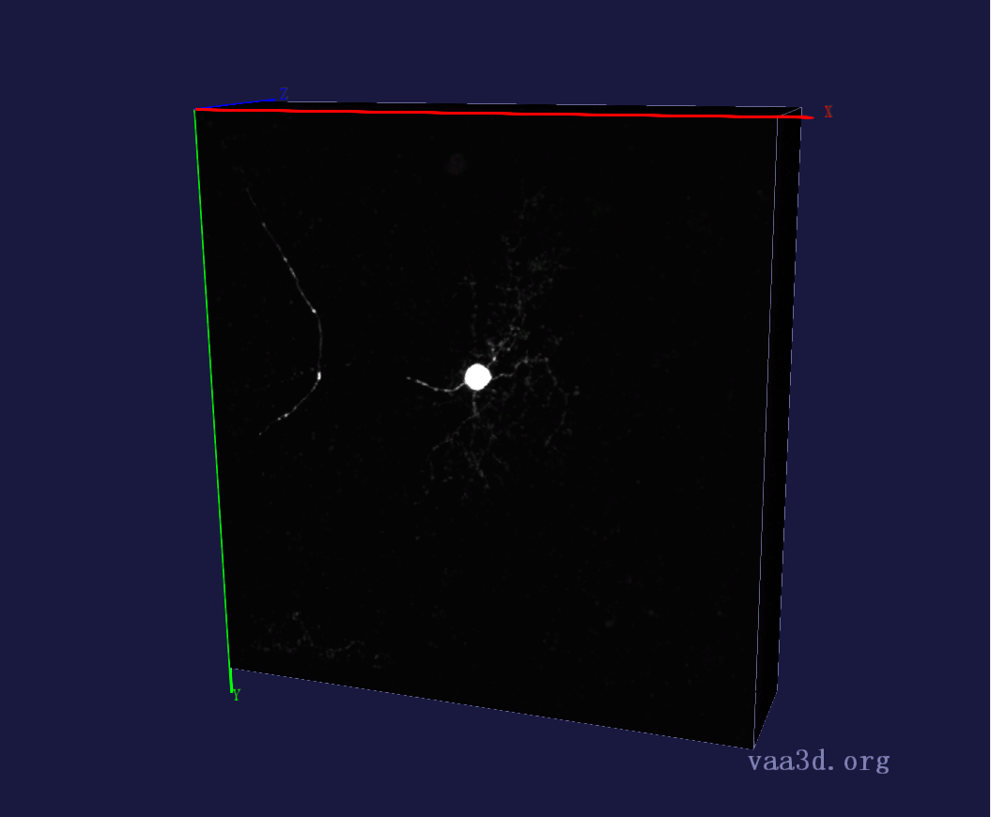
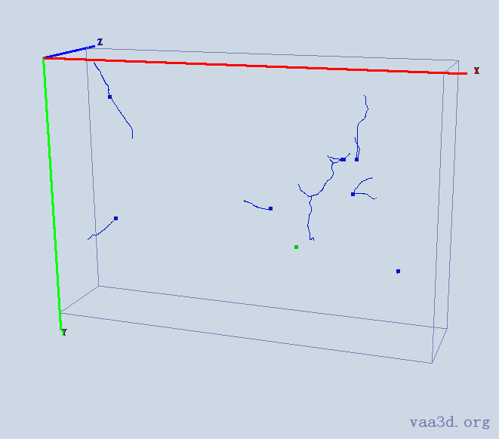
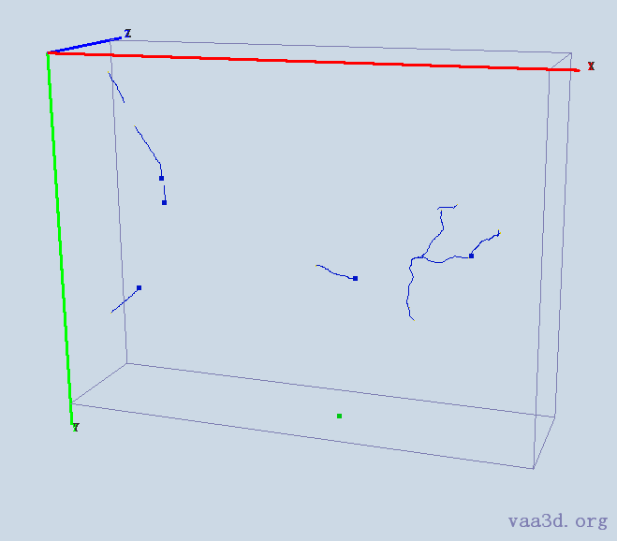
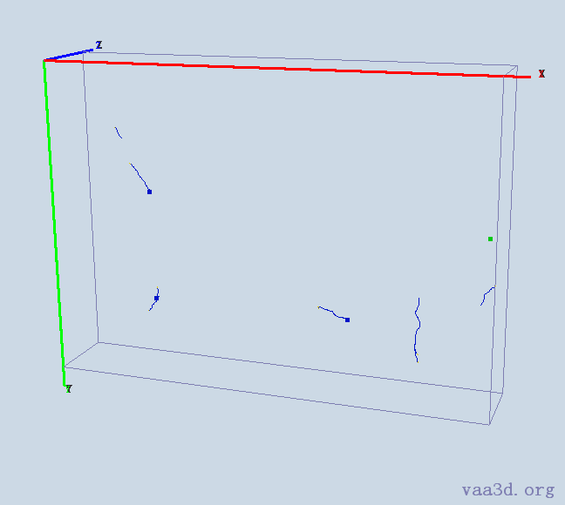
1_8_Ch2
GT
Thre=10
Thre=15
Thre=30
Thre=40
Thre=50

Slide 3
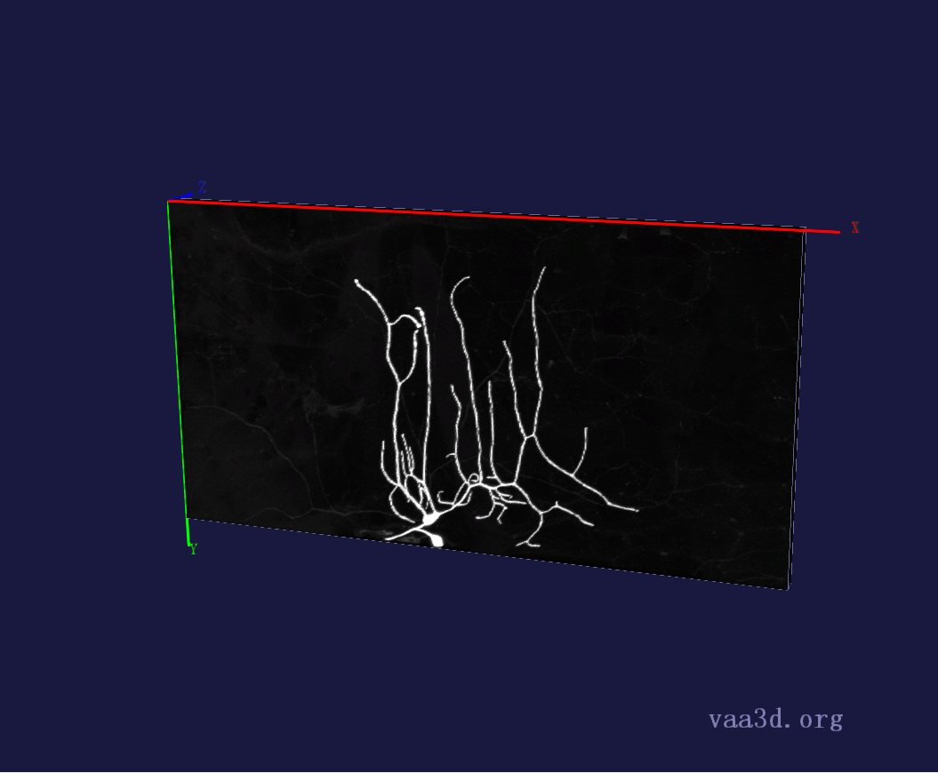
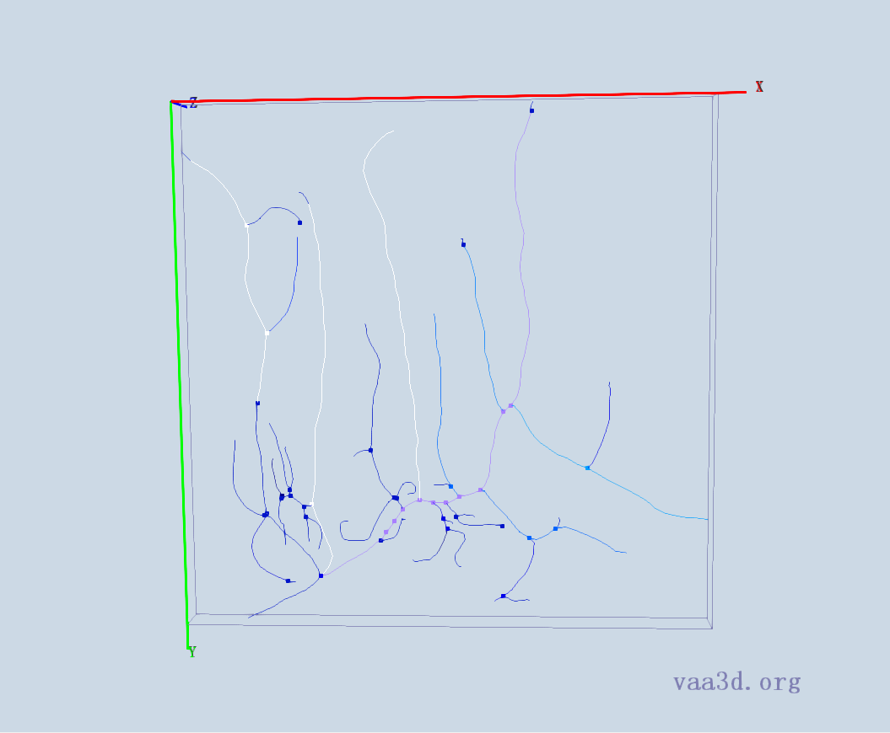
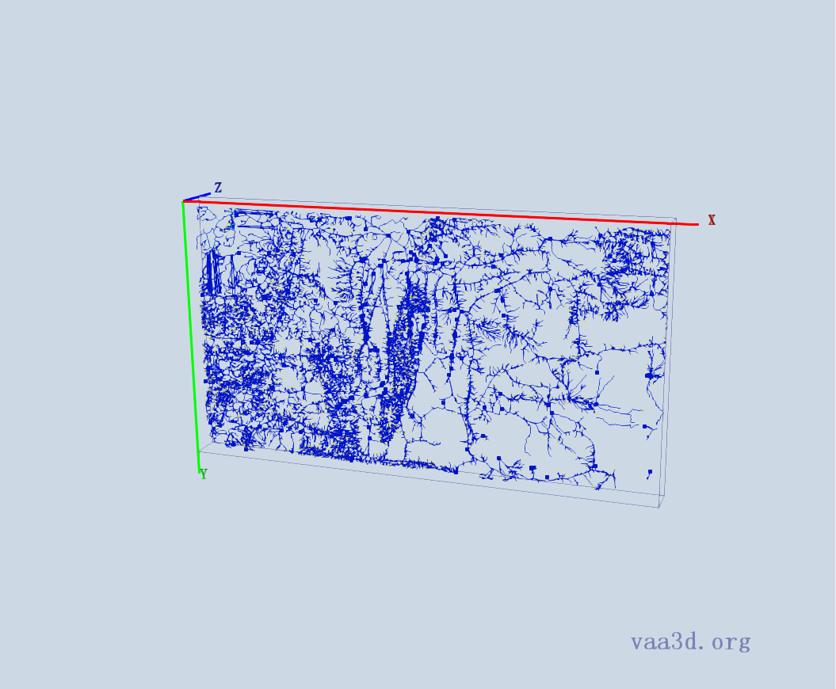
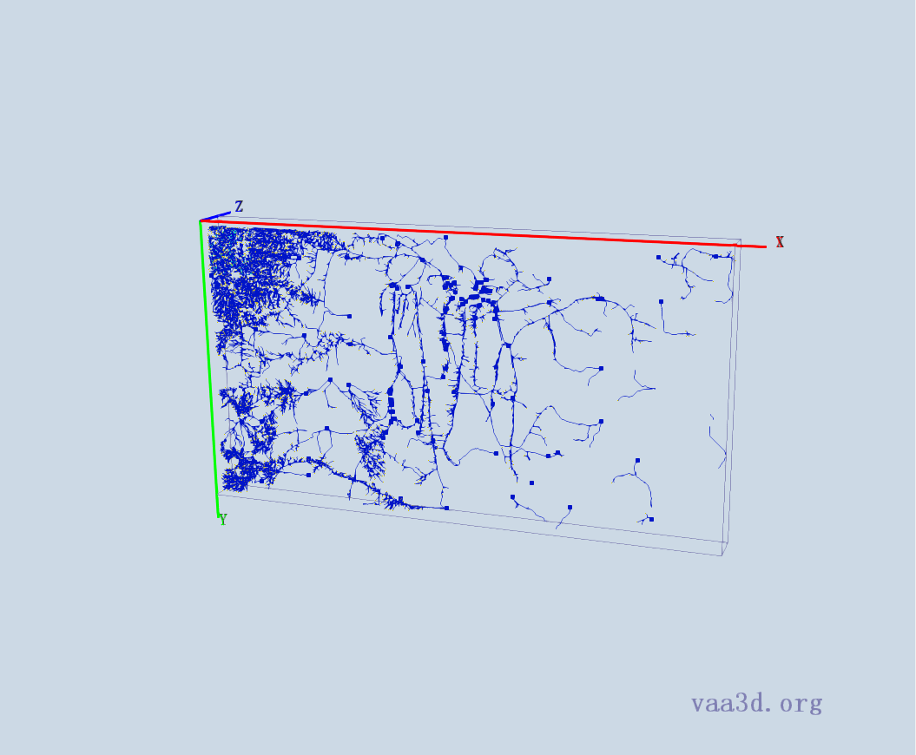
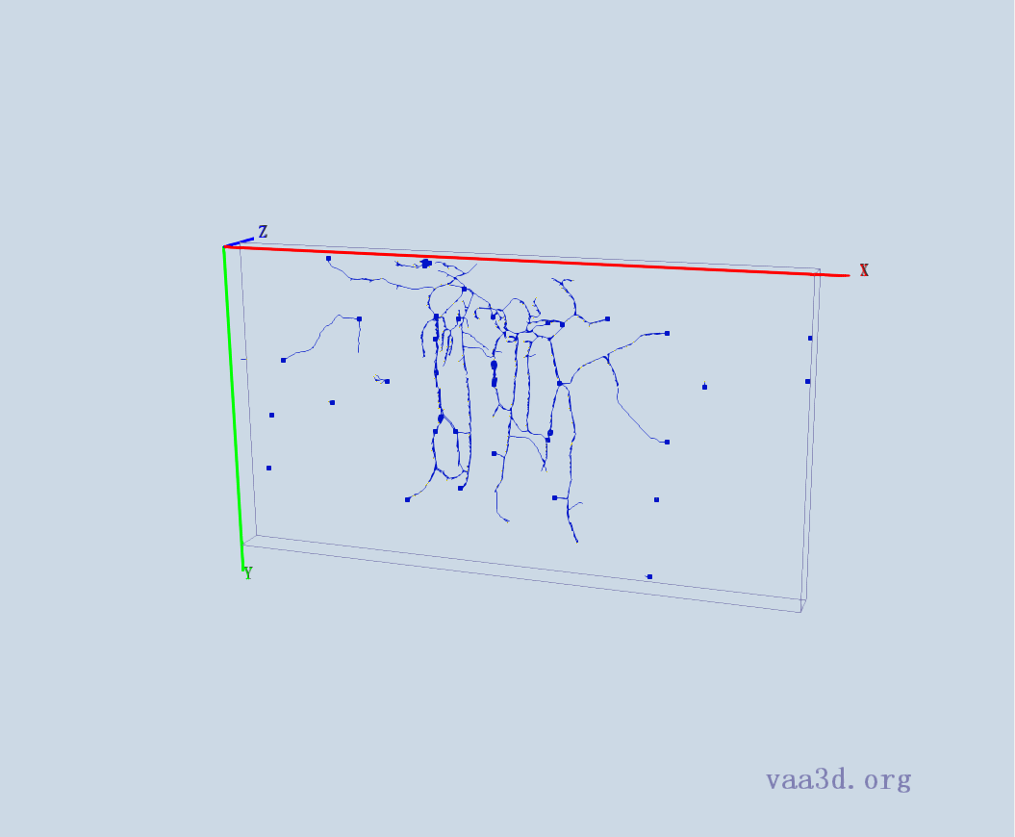
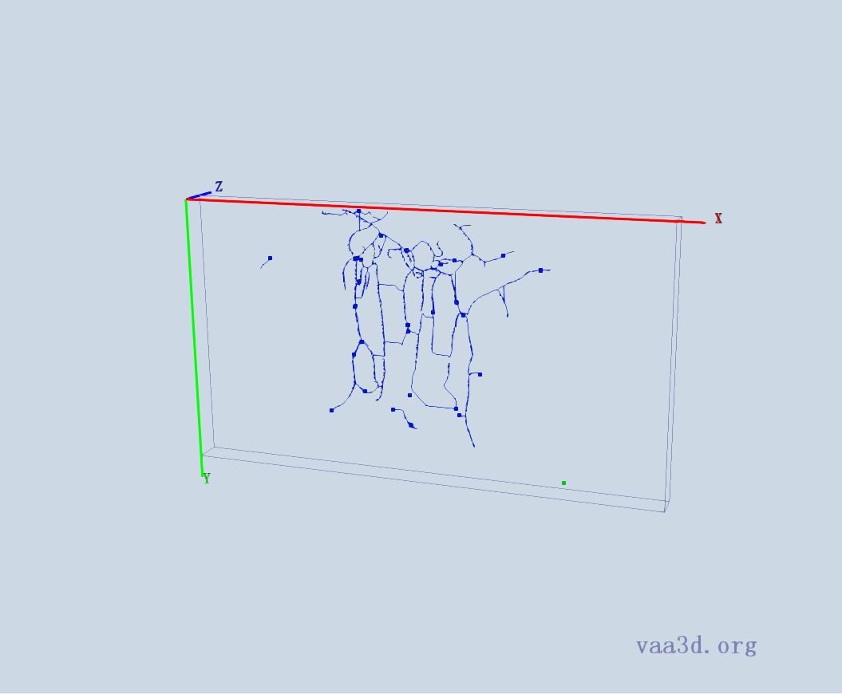
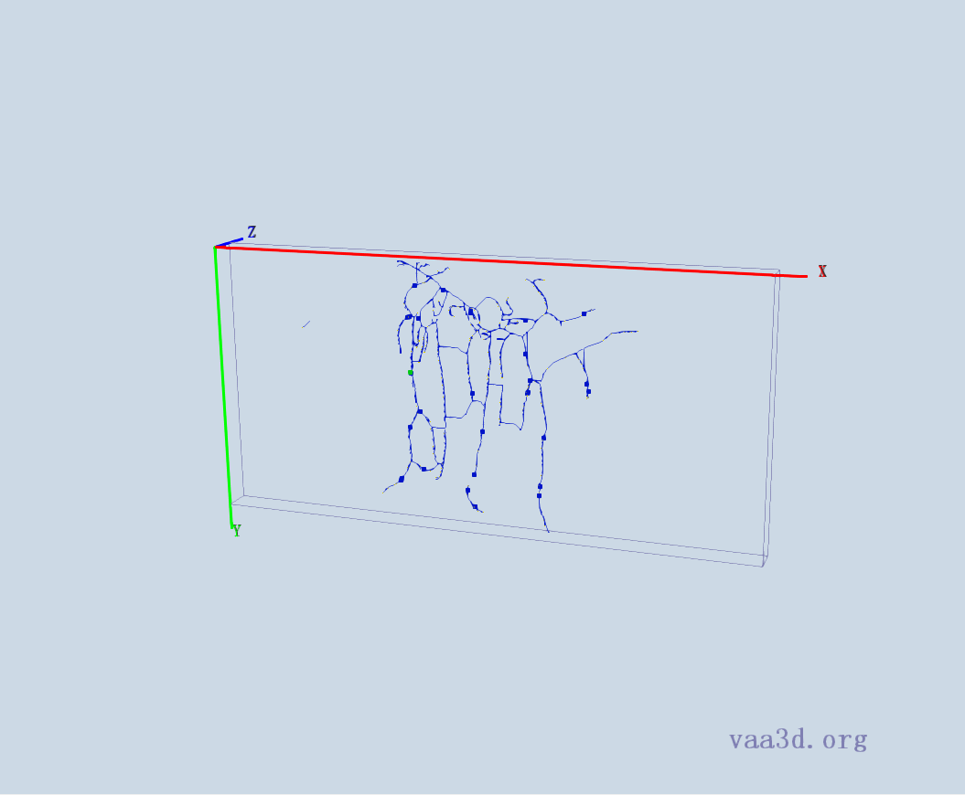
2_CL-I_Membrane-GFP_X_F-Actin-Red_ddaE
GT
Thre=10
Thre=15
Thre=30
Thre=40
Thre=50

Slide 4
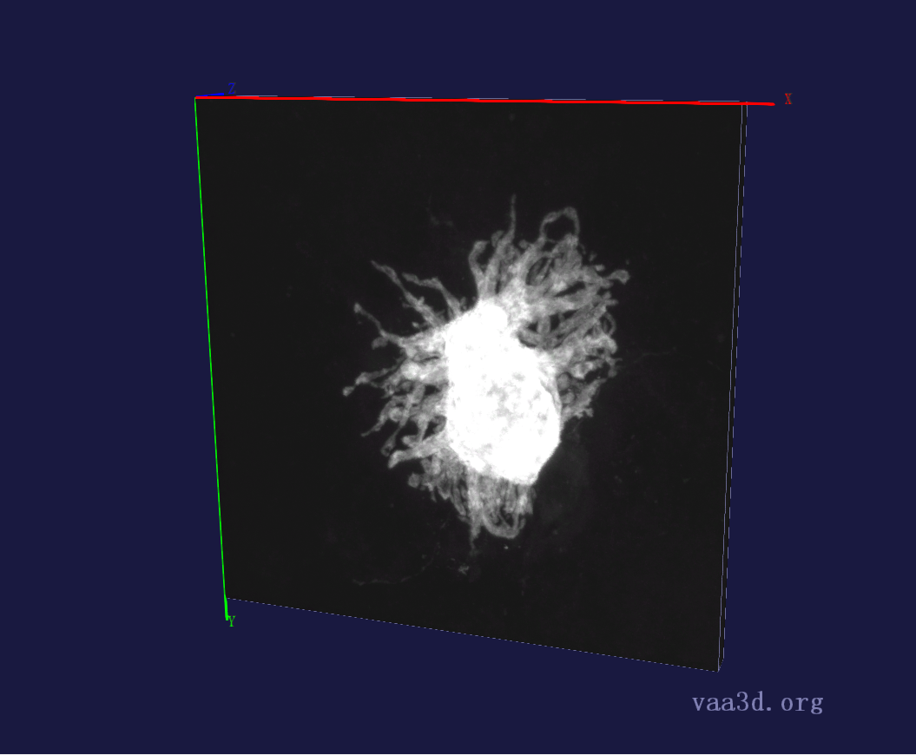
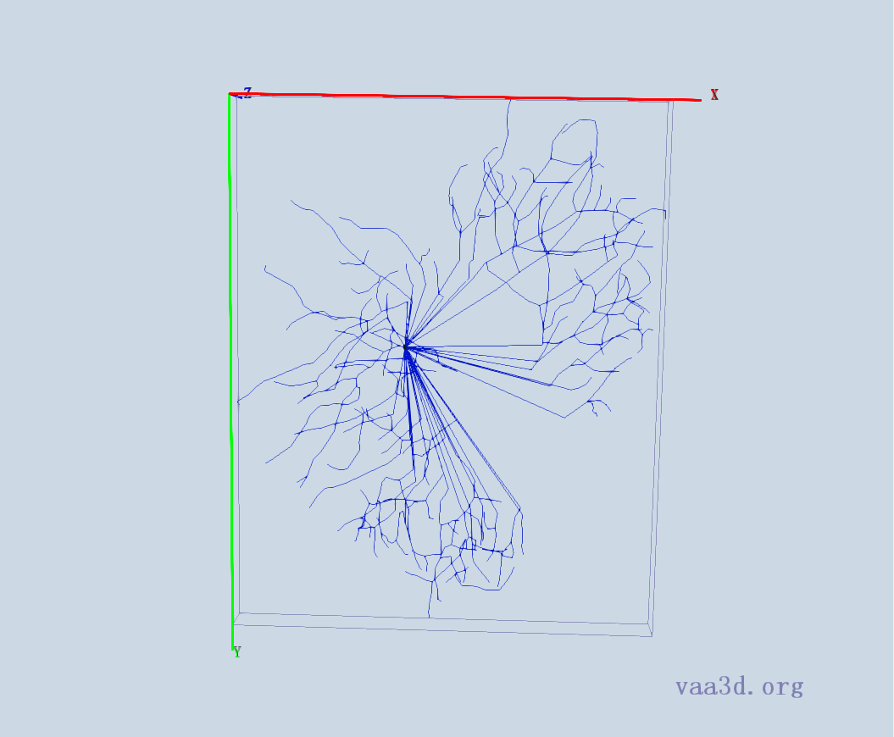
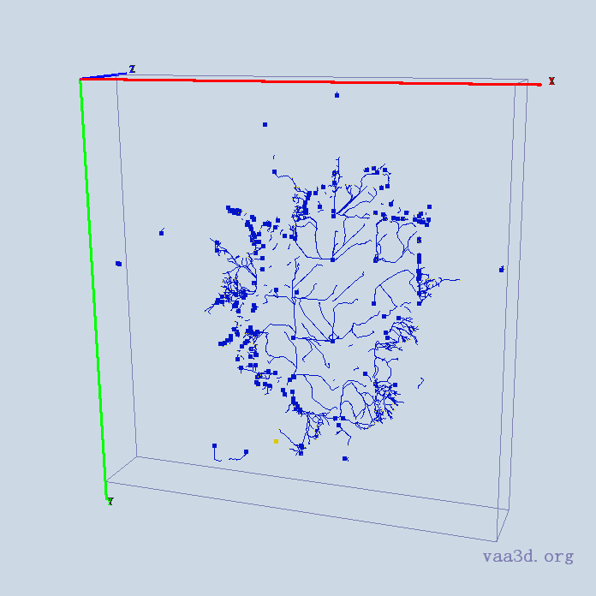
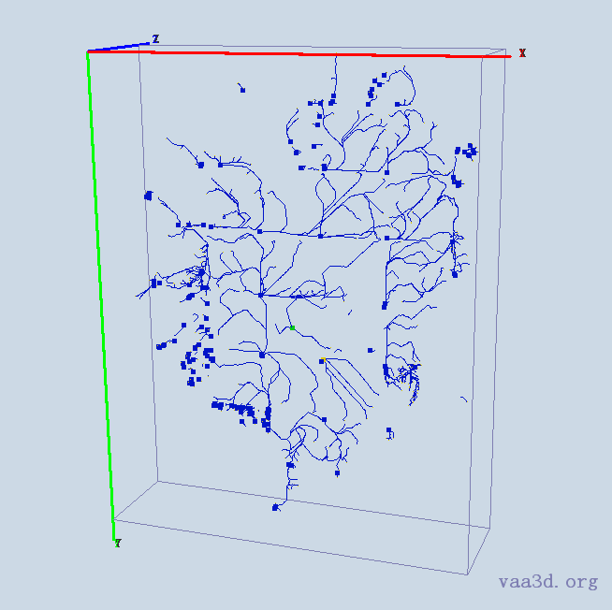
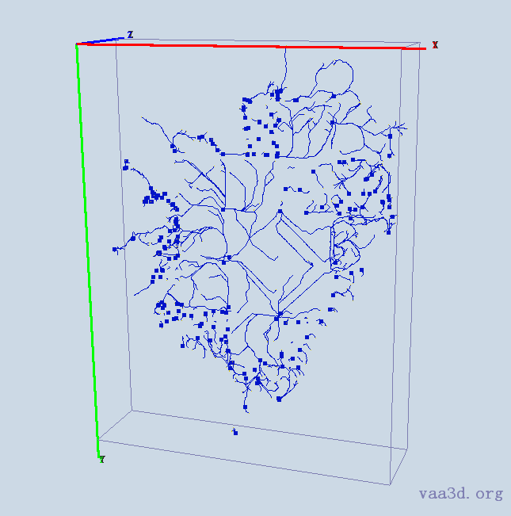
10-2909-s5-left-cell3_merge_c2
10-2909-s5-left-cell3_merge_c2
GT
Thre=10
Thre=15
Thre=30
Thre=40
Thre=50

Slide 5
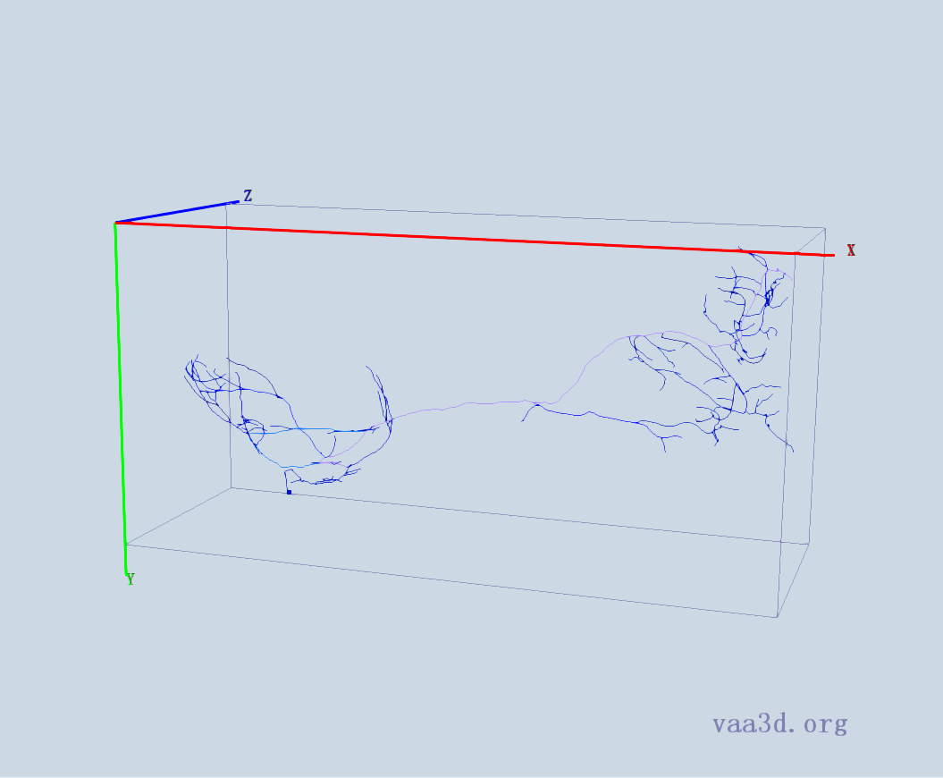
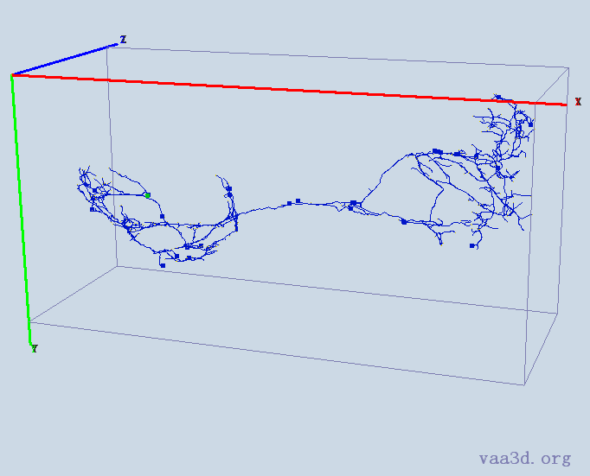


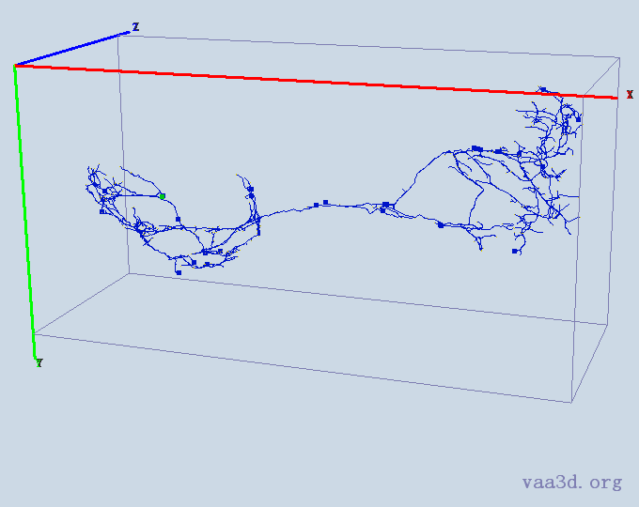

0664_seg
GT
Thre=10
Thre=15
Thre=30
Thre=40
Thre=50

Slide 6
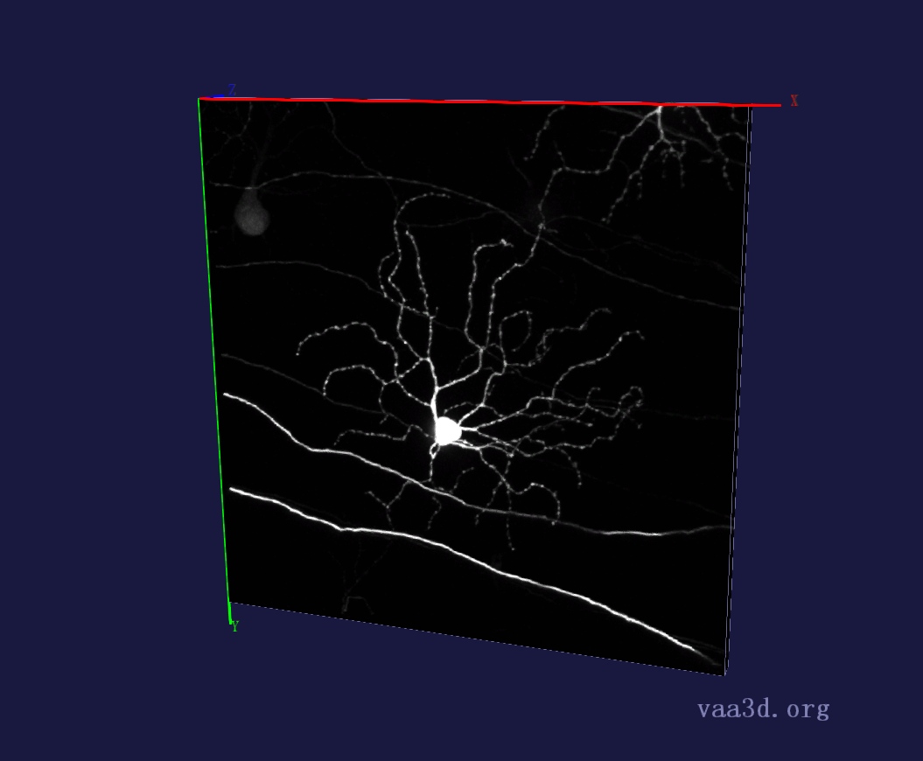
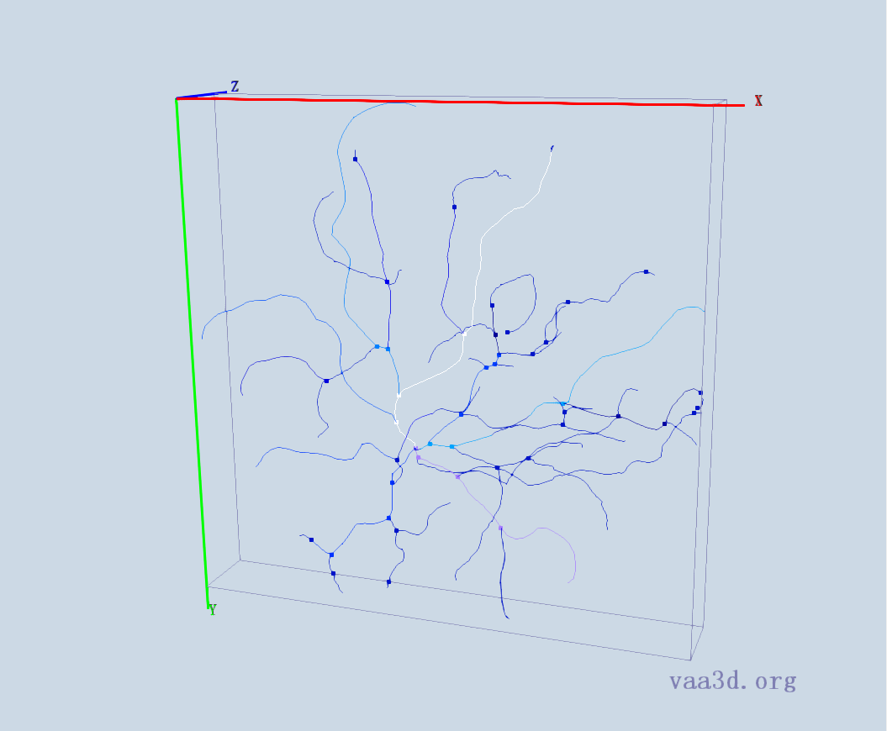
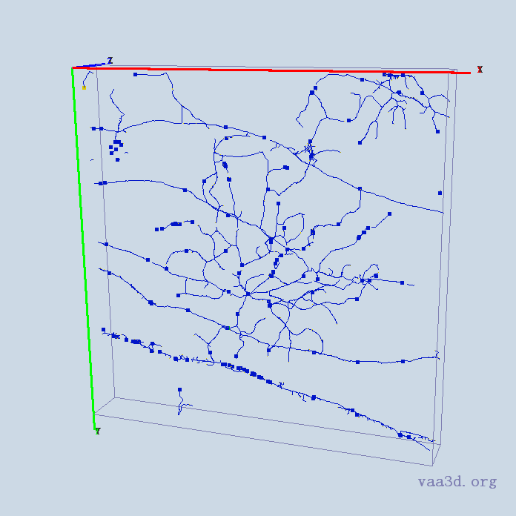
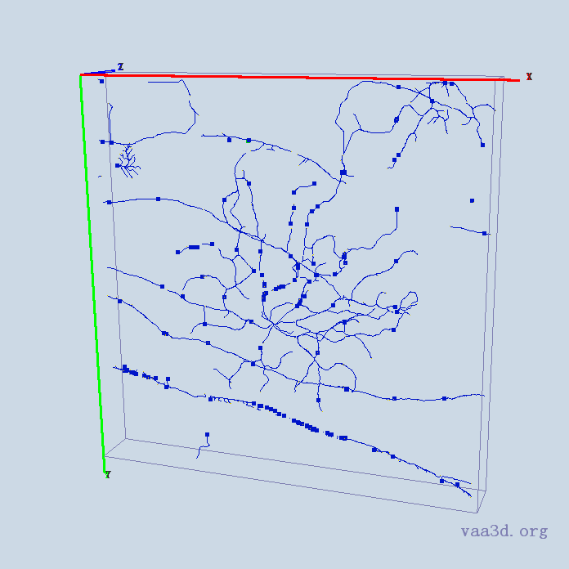
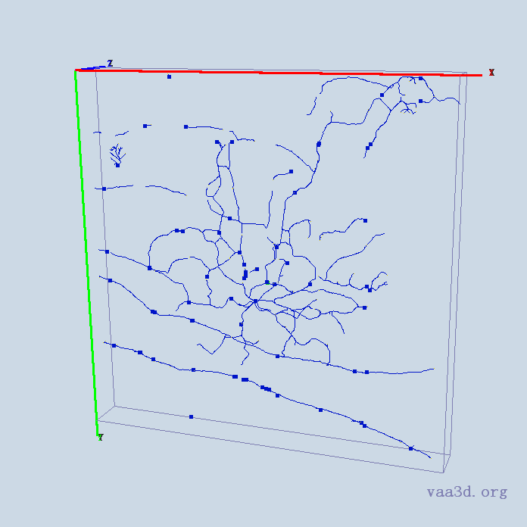
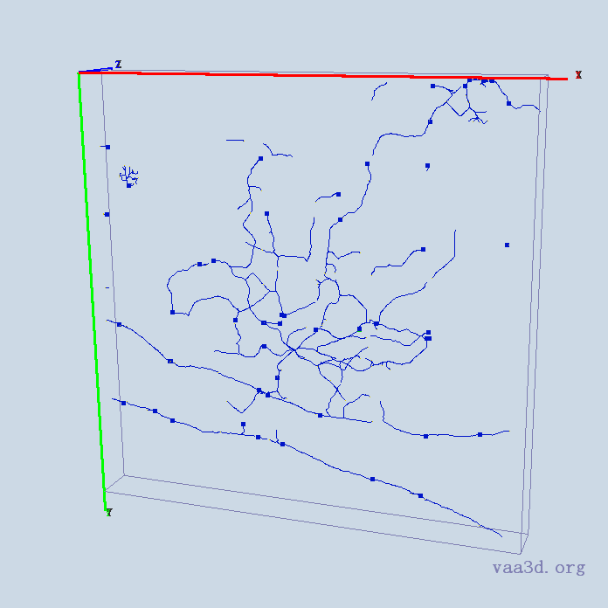
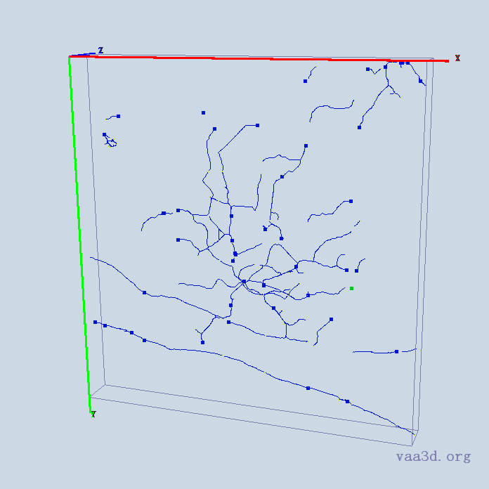
140918c8
GT
Thre=10
Thre=15
Thre=30
Thre=40
Thre=50

Slide 7
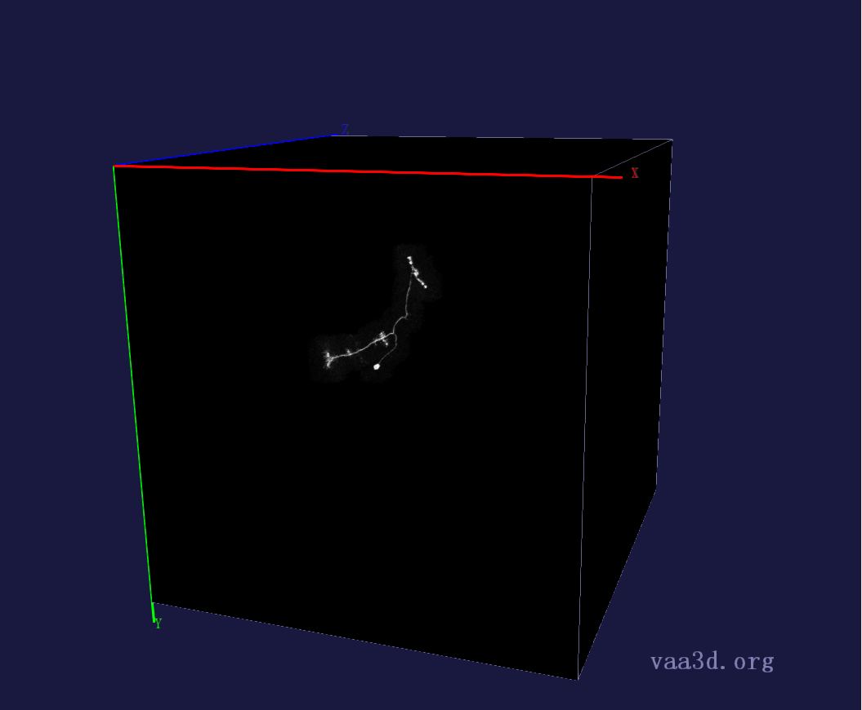
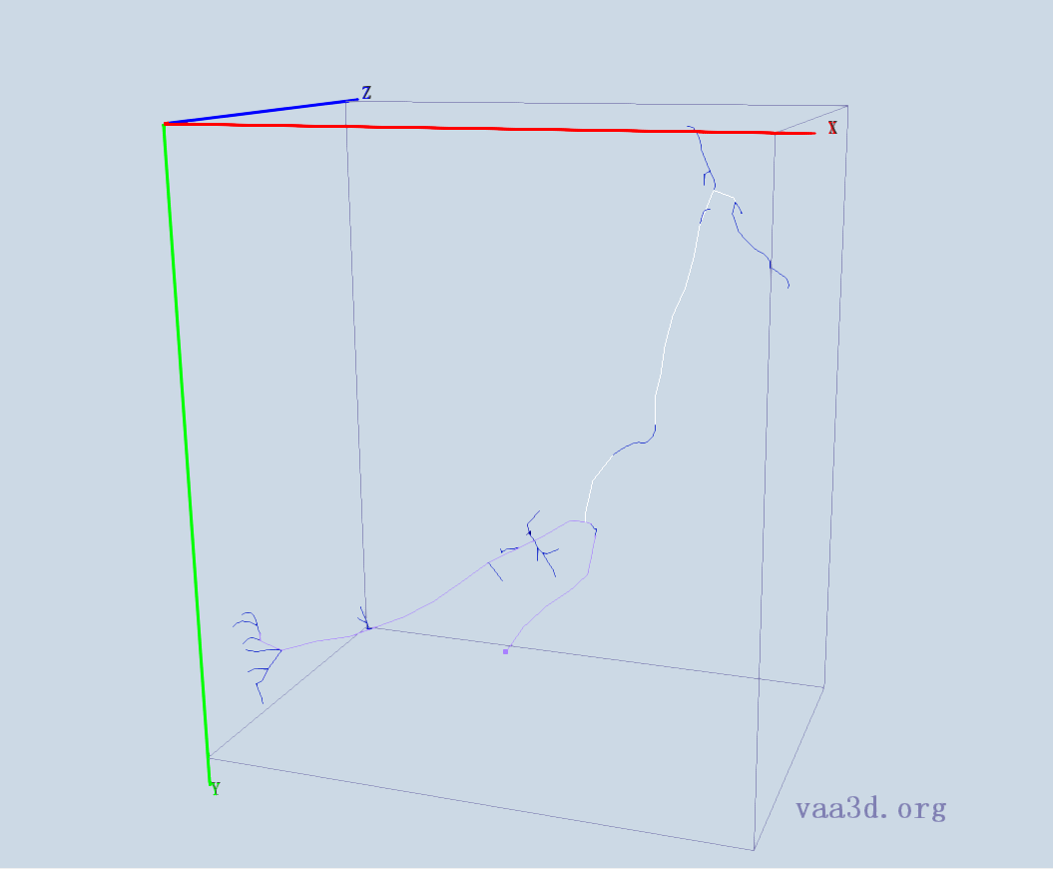
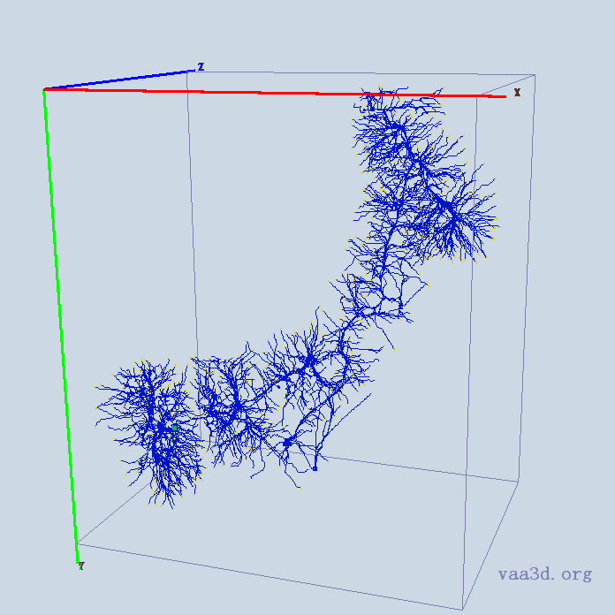
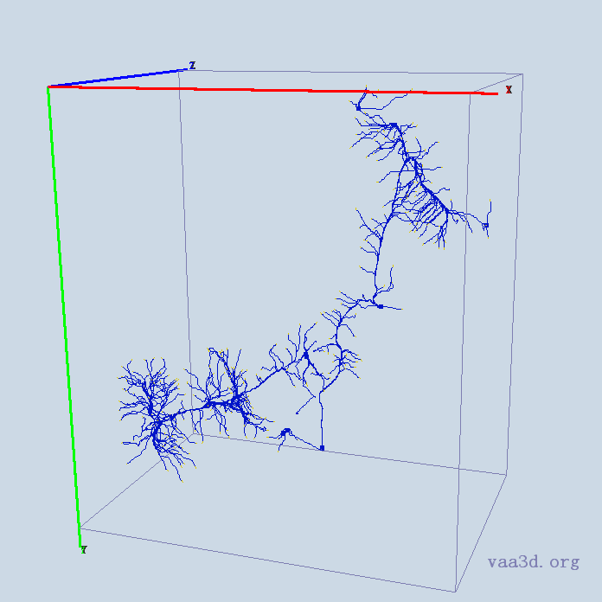
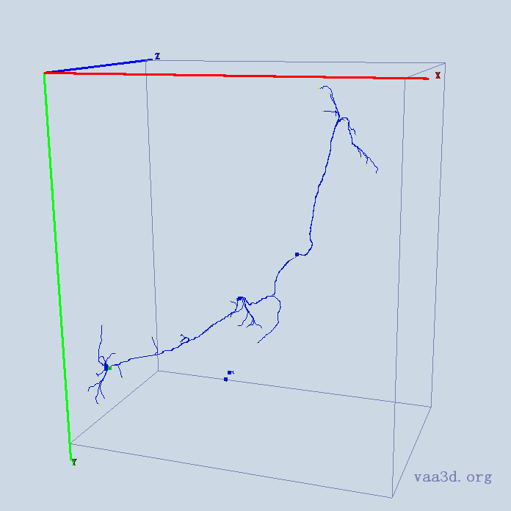
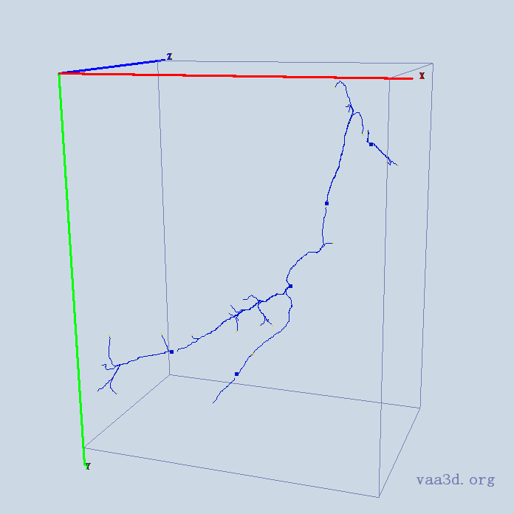
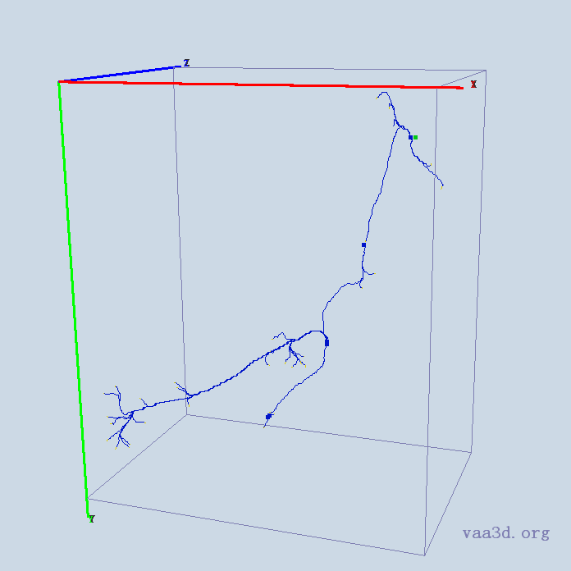
GMR_A3-
GT
Thre=10
Thre=15
Thre=30
Thre=40
Thre=50

Slide 8
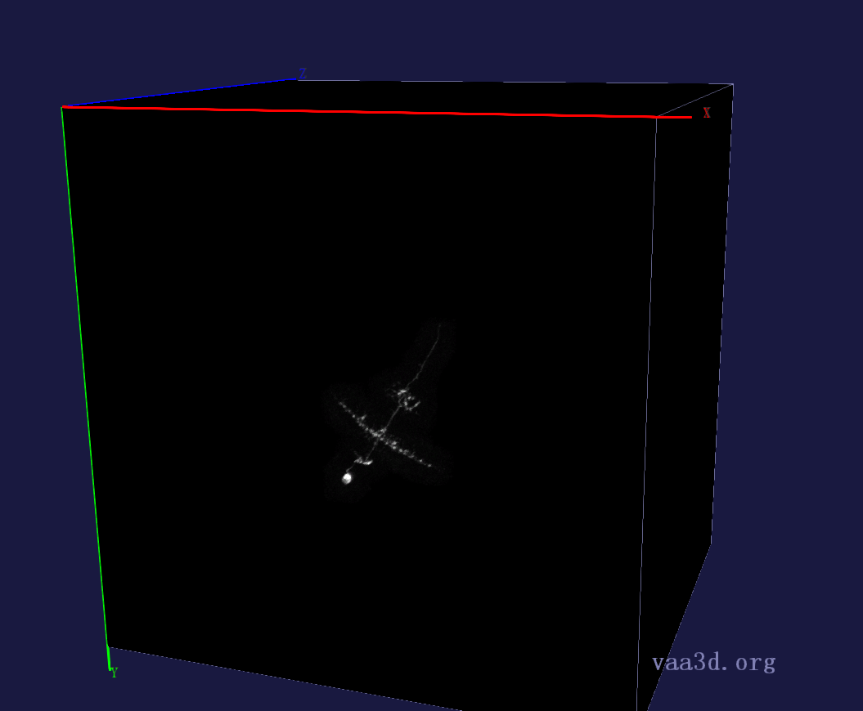
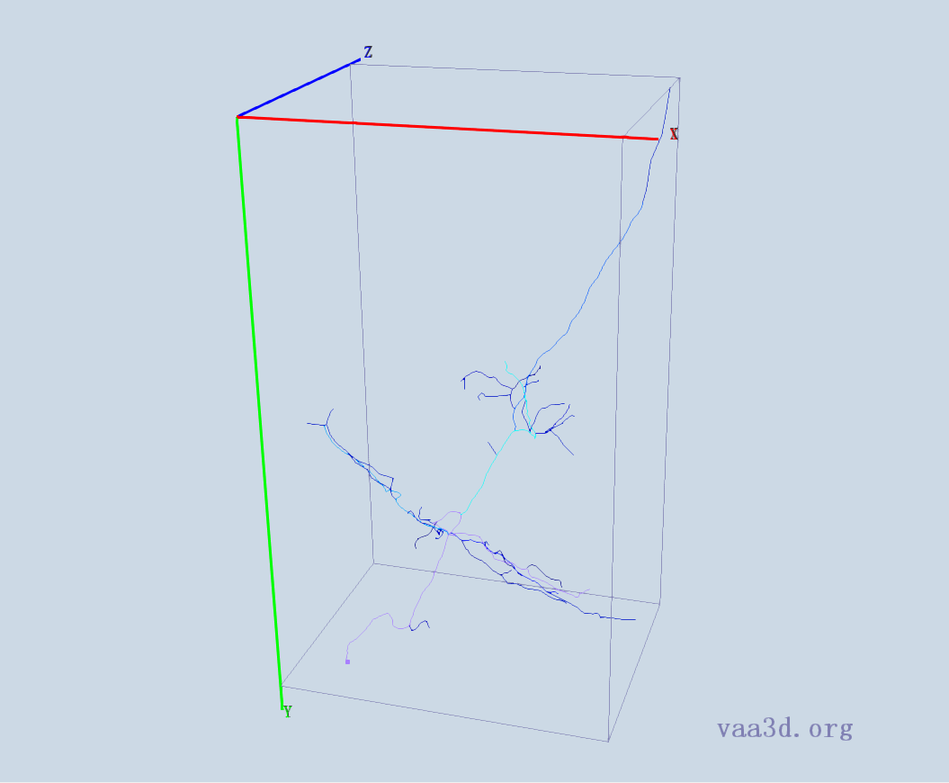
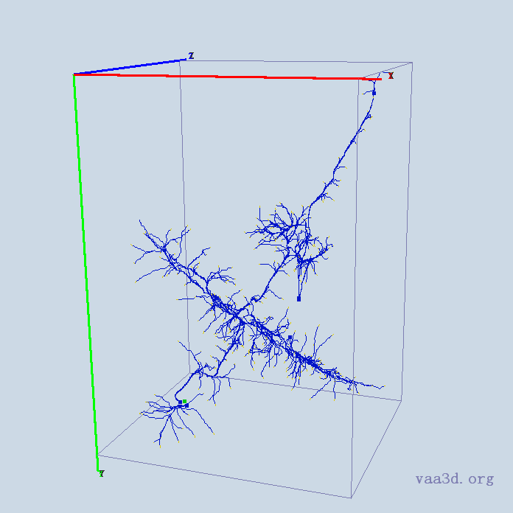
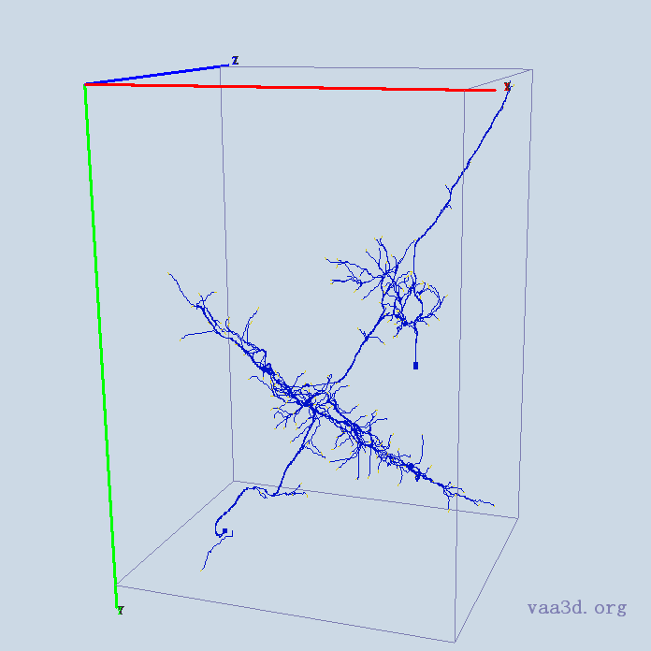
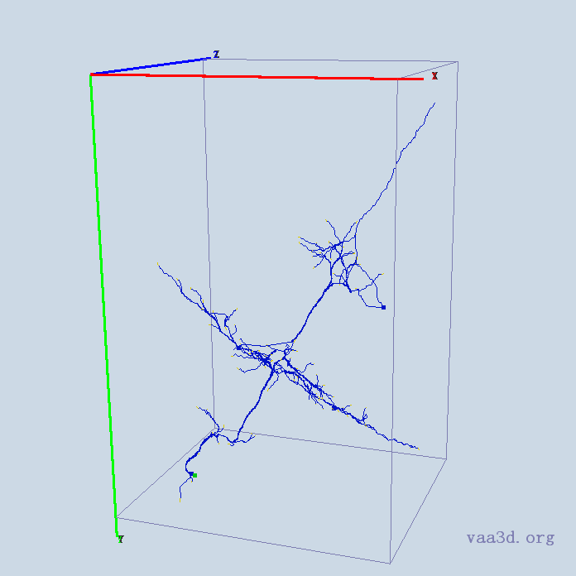
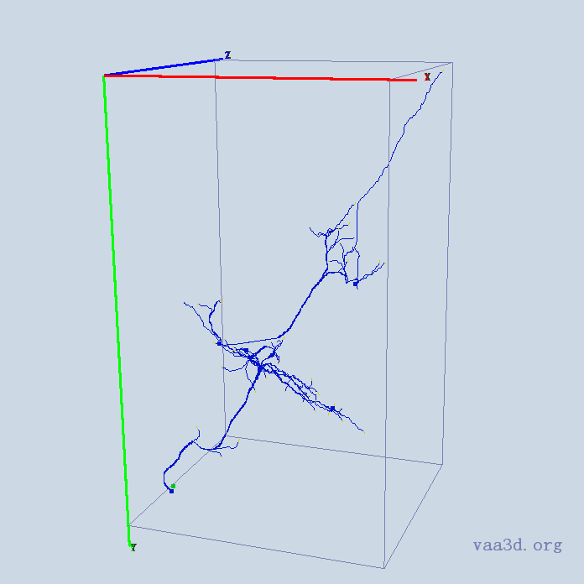
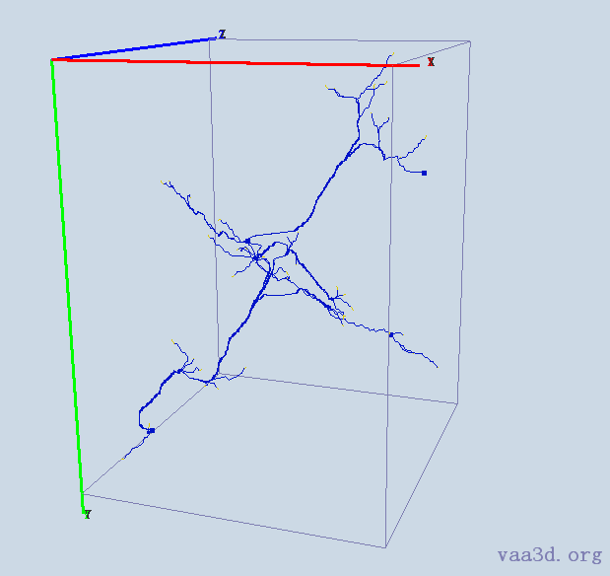
GMR_B2
GT
Thre=10
Thre=15
Thre=30
Thre=40
Thre=50

Slide 9
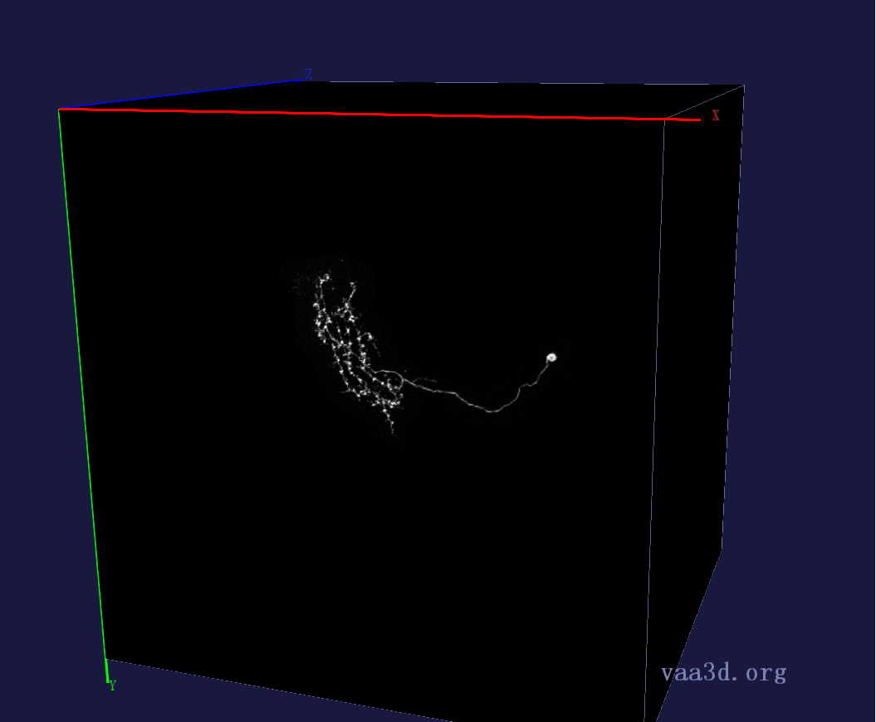
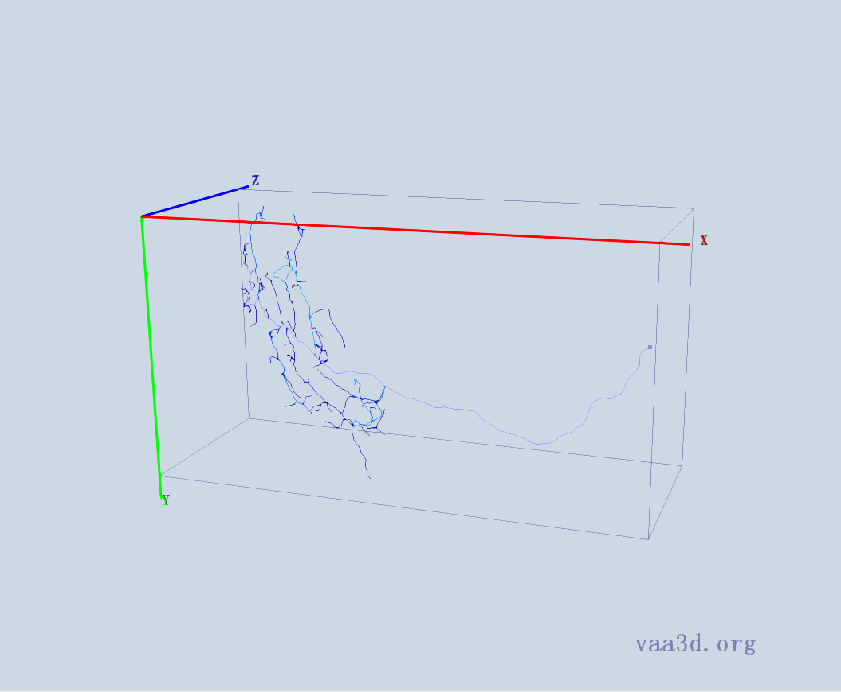





GMR_D3
GT
Thre=10
Thre=15
Thre=30
Thre=40
Thre=50

Slide 10







GMR_C1
GT
Thre=10
Thre=15
Thre=30
Thre=40
Thre=50

Slide 11







GMR_D2
GT
Thre=10
Thre=15
Thre=30
Thre=40
Thre=50

Slide 12







GMR_E1
GT
Thre=10
Thre=15
Thre=30
Thre=40
Thre=50

Slide 13







GMR_E2
GT
Thre=10
Thre=15
Thre=30
Thre=40
Thre=50

Slide 14







GMR_E4
GT
Thre=10
Thre=15
Thre=30
Thre=40
Thre=50

Slide 15







GMR_F3
GT
Thre=10
Thre=15
Thre=30
Thre=40
Thre=50

Slide 16







Image-7
GT
Thre=10
Thre=15
Thre=30
Thre=40
Thre=50

Slide 17








Image-10
GT
Thre=10
Thre=15
Thre=30
Thre=40
Thre=50

